Slide 1
RNA-Seq & the eukaryotic transcriptome (or how to stop worrying and start embracing the inaccuracies in RNA-Seq data analysis)
Radhika Khetani
October 7th 2013

Slide 2
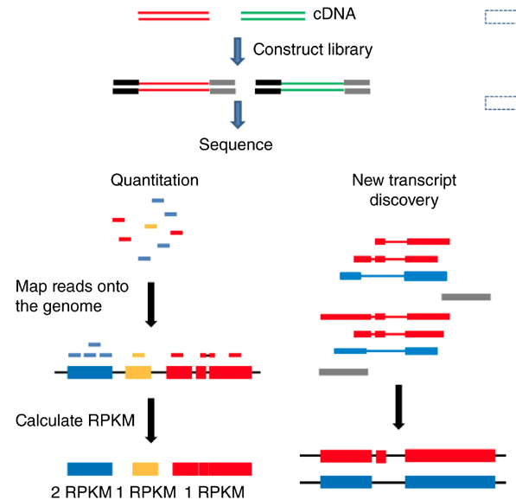
RNA-Seq workflow for gene expression analysis
Fragmented mRNA
List of differentially expressed genes
Adapted from Zeng and Mortazavi, Nature Immunology 13 (2012)

Slide 3
RNA-Seq Mapping Errors When Using Incomplete Reference
Transcriptomes of Vertebrates
Alexis Black Pyrkosz¹, Hans Cheng¹, C. Titus Brown²
¹ Avian Disease Oncology Laboratory, USDA, East Lansing, MI, USA
² Microbiology Department, Michigan State University, East Lansing, MI, USA
arXiv:1303.2411v1 [q-bio.GN] 11 Mar 2013

Slide 4
RNA-Seq workflow for gene expression analysis
Splice-aware alignment of reads to the Genome
Get counts at genic or isoform level using the appropriate transcriptome
Statistical analysis to obtain the list of differentially expressed genes/transcripts

Slide 5
RNA-Seq workflow for gene expression analysis
Map reads directly to the transcriptome fasta, and do a simple count of reads per transcript
Uniquely mapping reads only
Multiply mapping reads
- Best hit or Random hit
- Report all hits
Statistical analysis to obtain the list of differentially expressed genes/transcripts

Slide 6
RNA-Seq workflow for gene expression analysis
Map reads directly to the transcriptome fasta, and do a simple count of reads per transcript
How was the transcriptome assembled (depth of sequencing, algorithm)?
Were all the low-abundance genes accounted for?
How many of the genes have been validated on the bench?
Does the transcriptome account for all splice isoforms in the organism?
Does it account for all the paralogous genes?

Slide 7
RNA-Seq workflow for gene expression analysis
Map reads directly to the transcriptome fasta, and do a simple count of reads per transcript
Differential expression using counts for isoform transcripts?
- Missing isoforms
Differential expression using counts for consolidated genic trancripts?

Slide 8
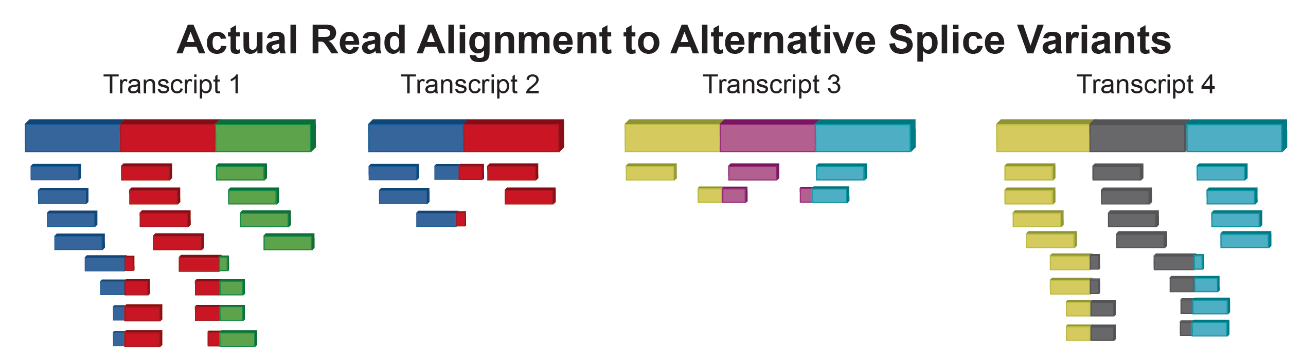
One Scenario

Slide 9
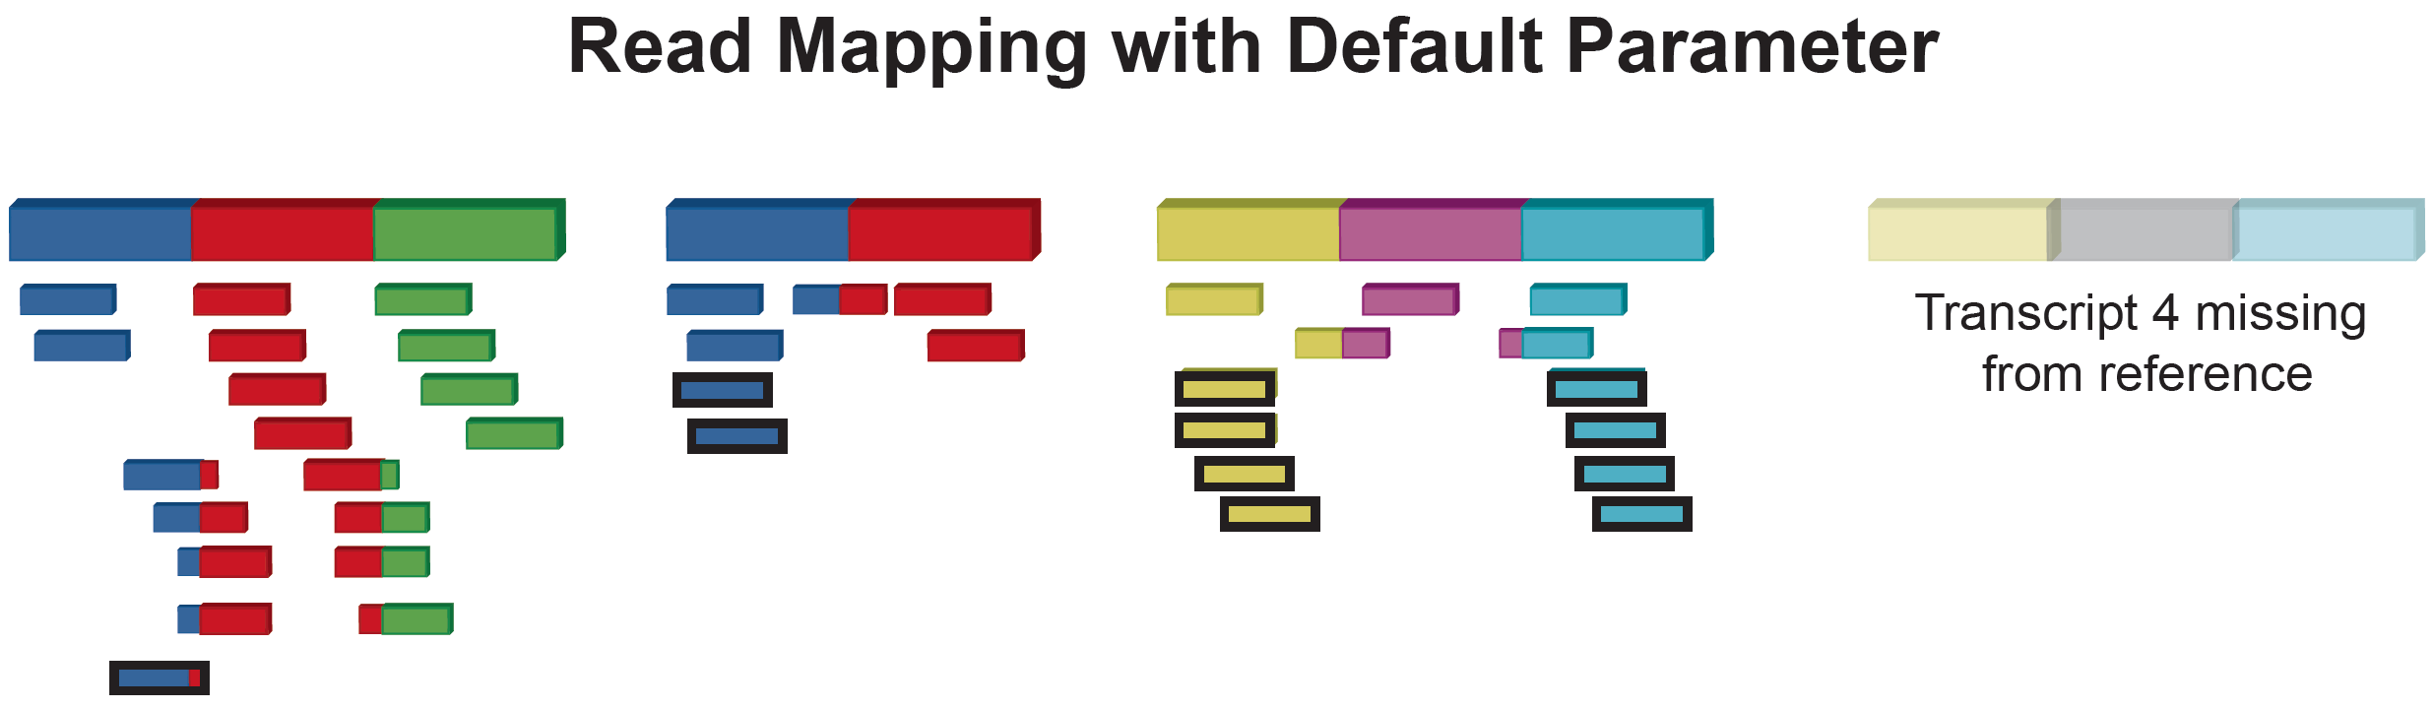
One Scenario
Incomplete Reference Transcriptome

Slide 10
One Scenario

Slide 11
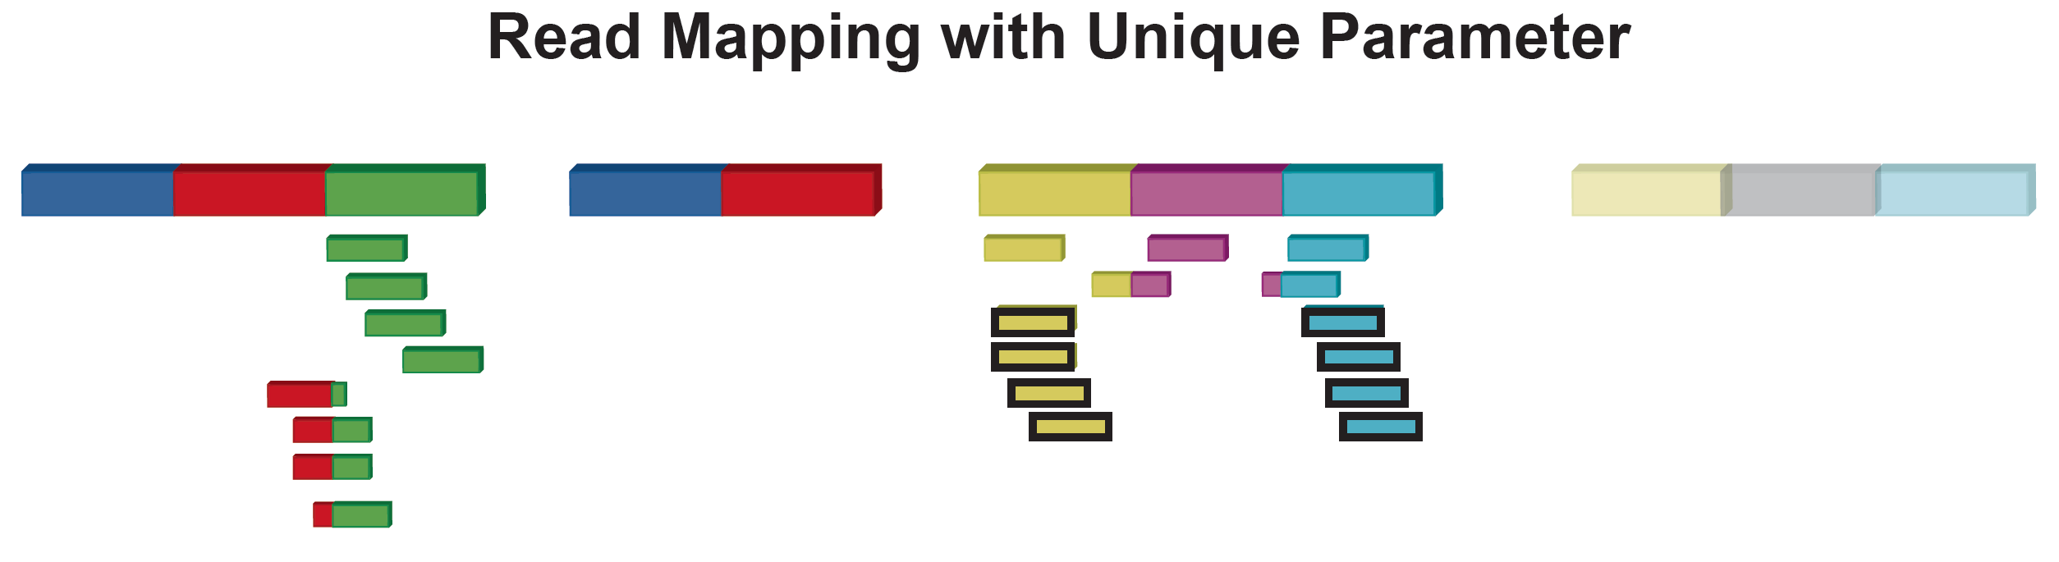
One Scenario

Slide 12
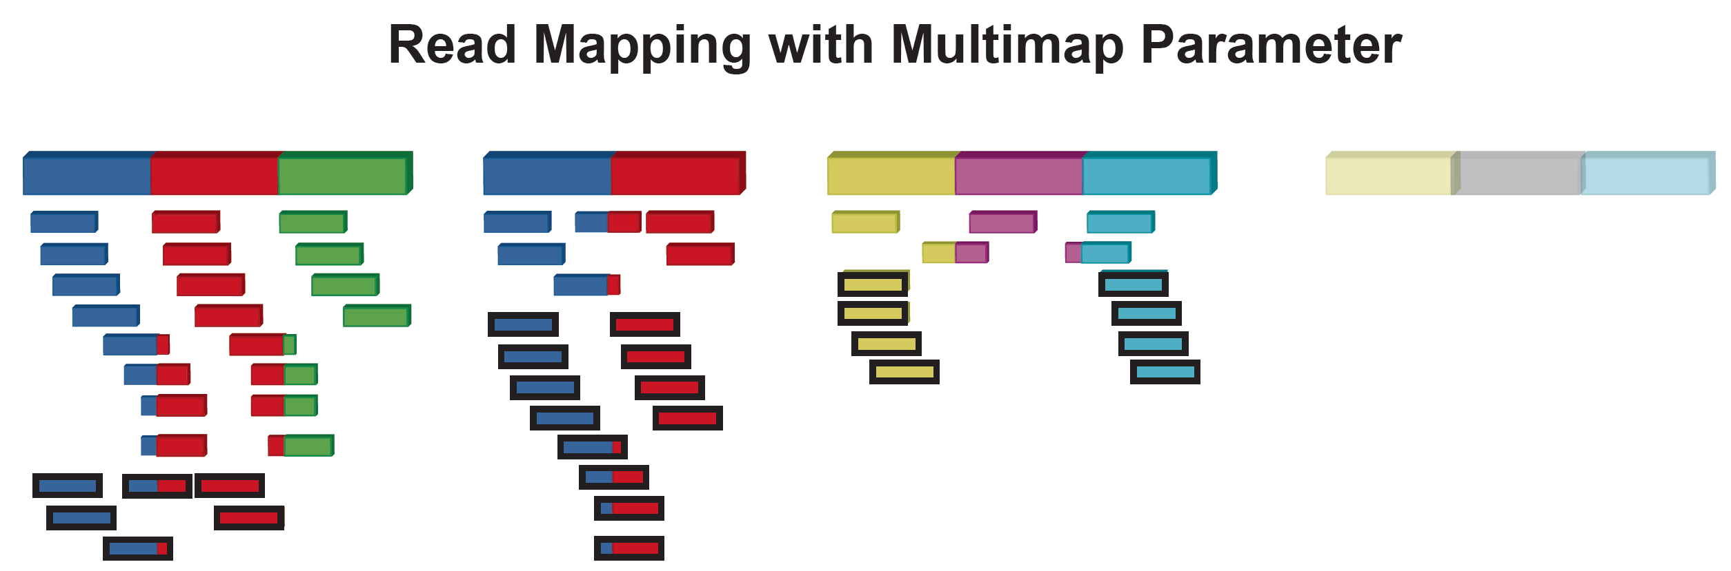
One Scenario

Slide 13
Experimental design details
2 vertebrate transcriptomes were used in the study
Chicken – Gallus gallus (relatively incomplete; fewer splice variants)
Mouse – Mus musculus (mostly complete; large number of splice variants)
Simulated random transcripts generated
Simulated splice variants introduced within the existing or random transcriptome
Existing or random transcriptome used to create read simulations
Single-end and paired-end reads of various lengths. For paired-end reads, varying fragment lengths used
A 1% error rate introduced, similar to that present in Illumina reads
The simulated reads generated to reflect varying coverage (20x, etc.)
Read alignment was done directly to the transcriptome using Bowtie
Measurements were done at the level of isoforms, unless otherwise specified
(All the Python scripts for read simulation, variant introduction etc. are freely available on github)

Slide 14
Terms used
“default” mapping = Reporting only the best hit, or only one of the many hits found
“reference” = known transcriptome
Specificity vs. Sensitivity – True positives vs. False positives
True positives – Reads that mapped to their originating transcripts
False positives – Reads that mapped to other transcripts (even if the read was an exact match to the alternate transcript)

Slide 15
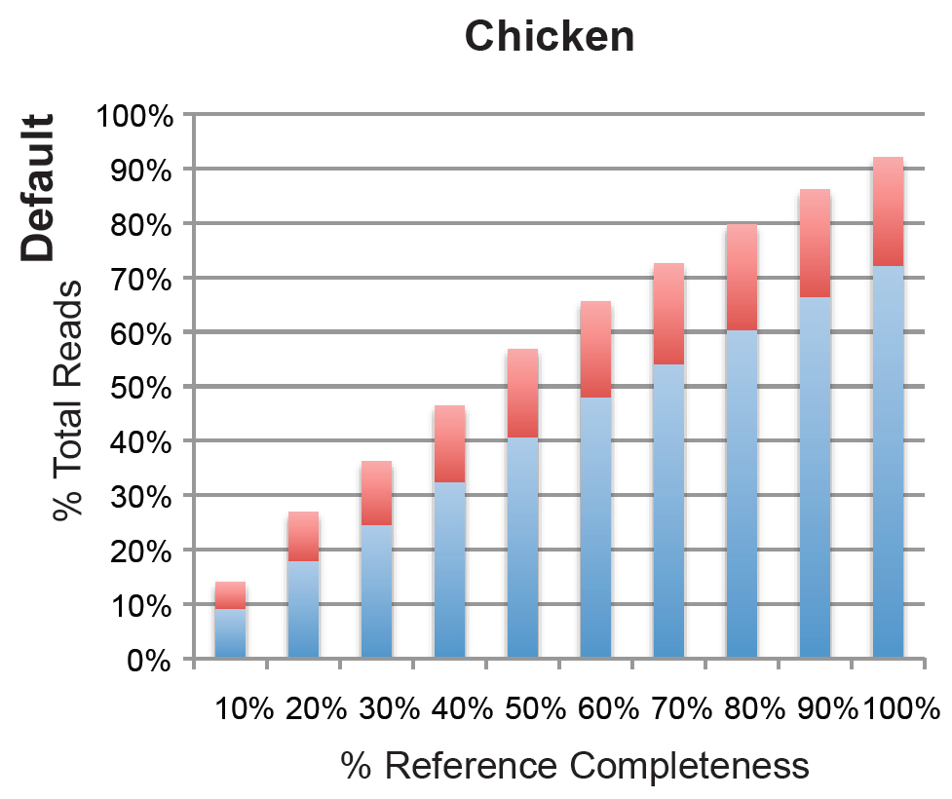

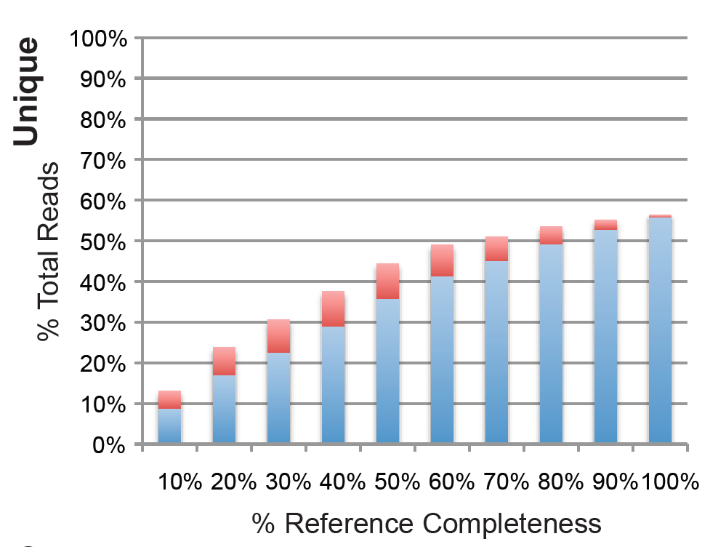
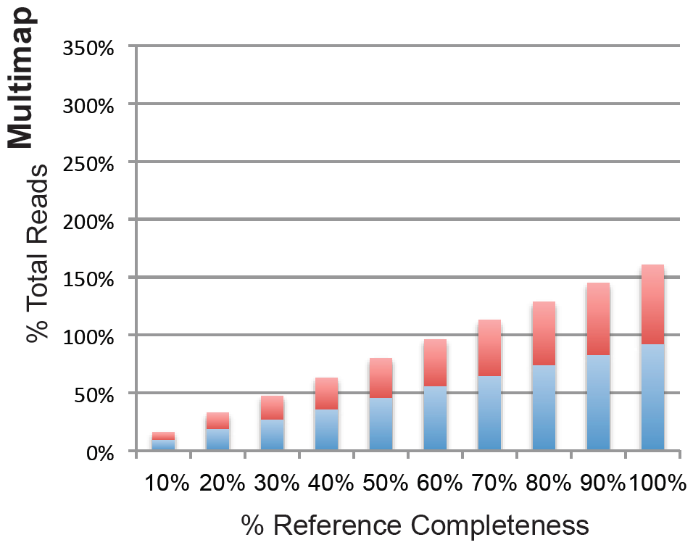
The “mode” used to map reads is important for mapping accuracy, especially if the transcriptome is incomplete
Chicken

Slide 16
The “mode” used to map reads is important for mapping accuracy, especially if the transcriptome is incomplete
Chicken
Multimap extended Y-axis

Slide 17
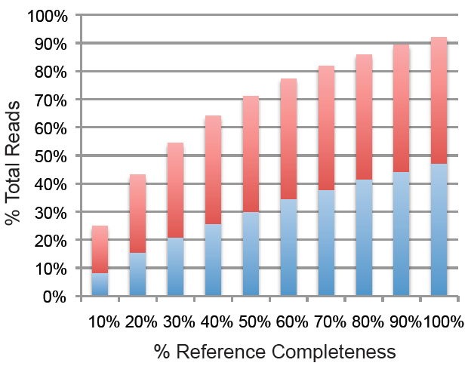
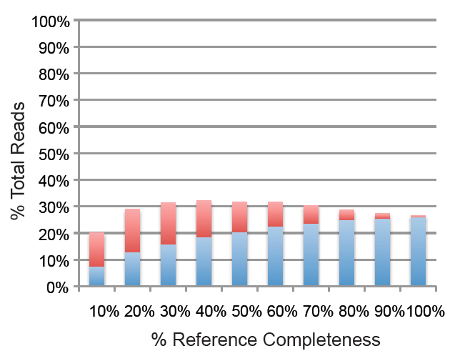
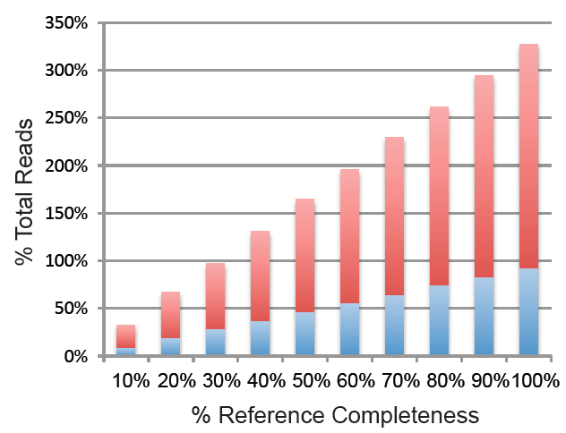
Default
The “mode” used to map reads is important for mapping accuracy, especially if the transcriptome is incomplete and has a lot of splice variants
Mouse
Unique
Multimap

Slide 18
The “mode” used to map reads is important for mapping accuracy, especially if the transcriptome is incomplete and has a lot of splice variants
Mouse
Multimap extended Y-axis
Default
Unique

Slide 19
The “mode” used to map reads is important for mapping accuracy, especially if the transcriptome is incomplete and has a lot of splice variants
Simulated transcriptome with 5000 genes
default
unique
multimap

Slide 20
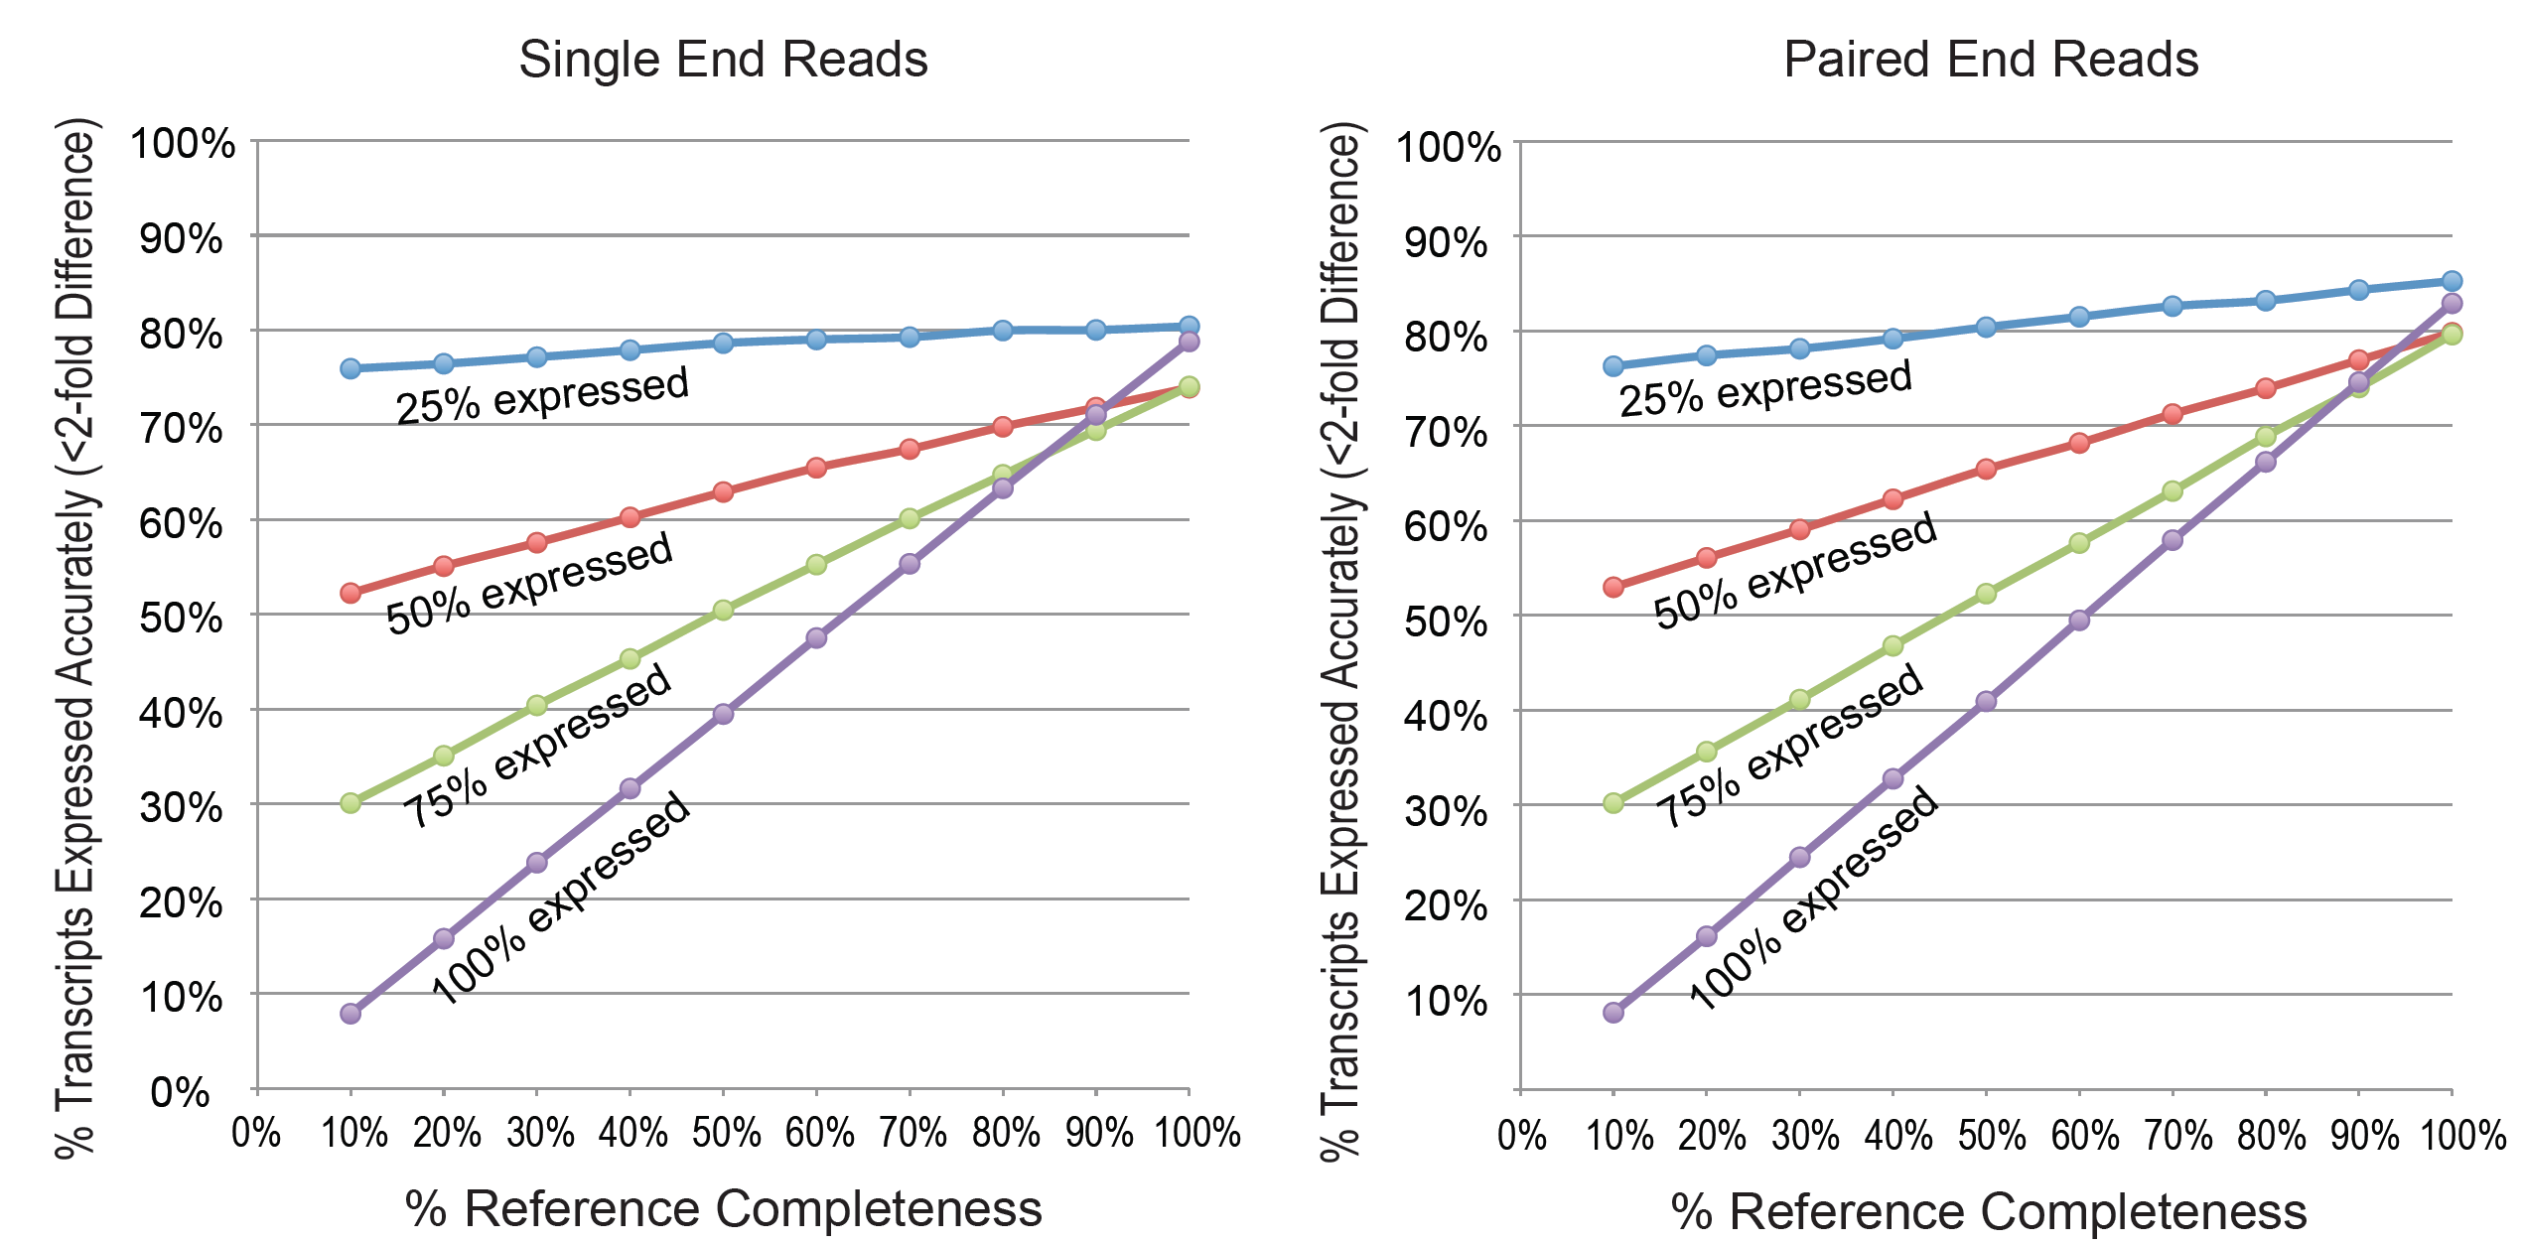
% of genes expressed can impact the accuracy of read mapping more adversely when the transcriptome is incomplete
Accurately expressing transcripts are those where
Number of mapped reads
(experimental)
------------------------------------------------
Number of reads generated from a
given transcript (actual)
=
< 2
Transcripts were grouped by genes for the purpose of counting reads (ENSEMBL genes)
default parameters for mapping?

Slide 21
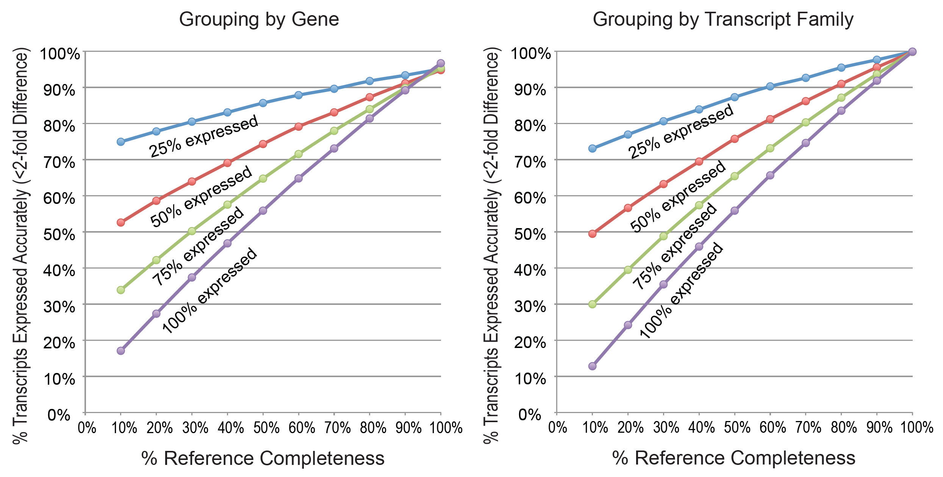
% of genes expressed can impact the accuracy of read mapping more adversely when the transcriptome is incomplete
Isoform-level counts are less accurate than gene-level counting
Confusing terminology!

Slide 22
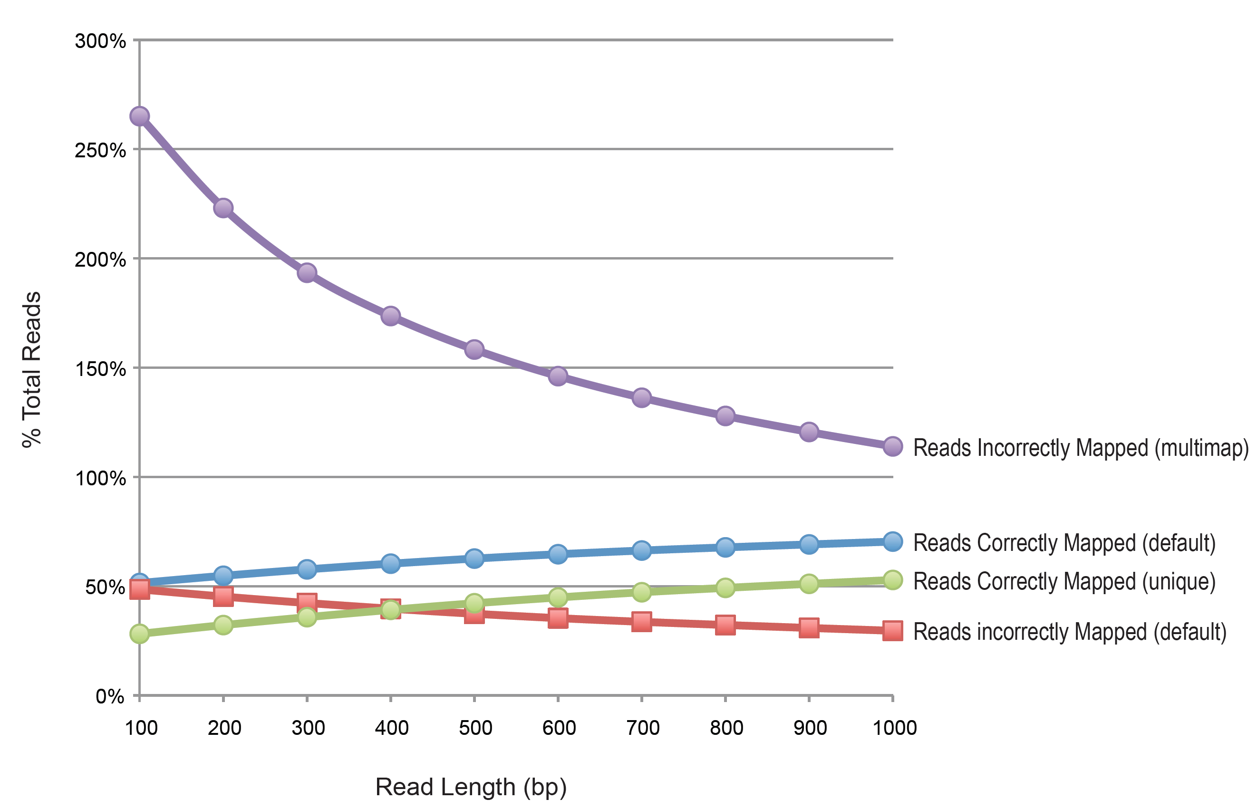
Read lengths improve accuracy, but the improvement is less than expected
(single-end reads and 20x coverage; mouse)

Slide 23
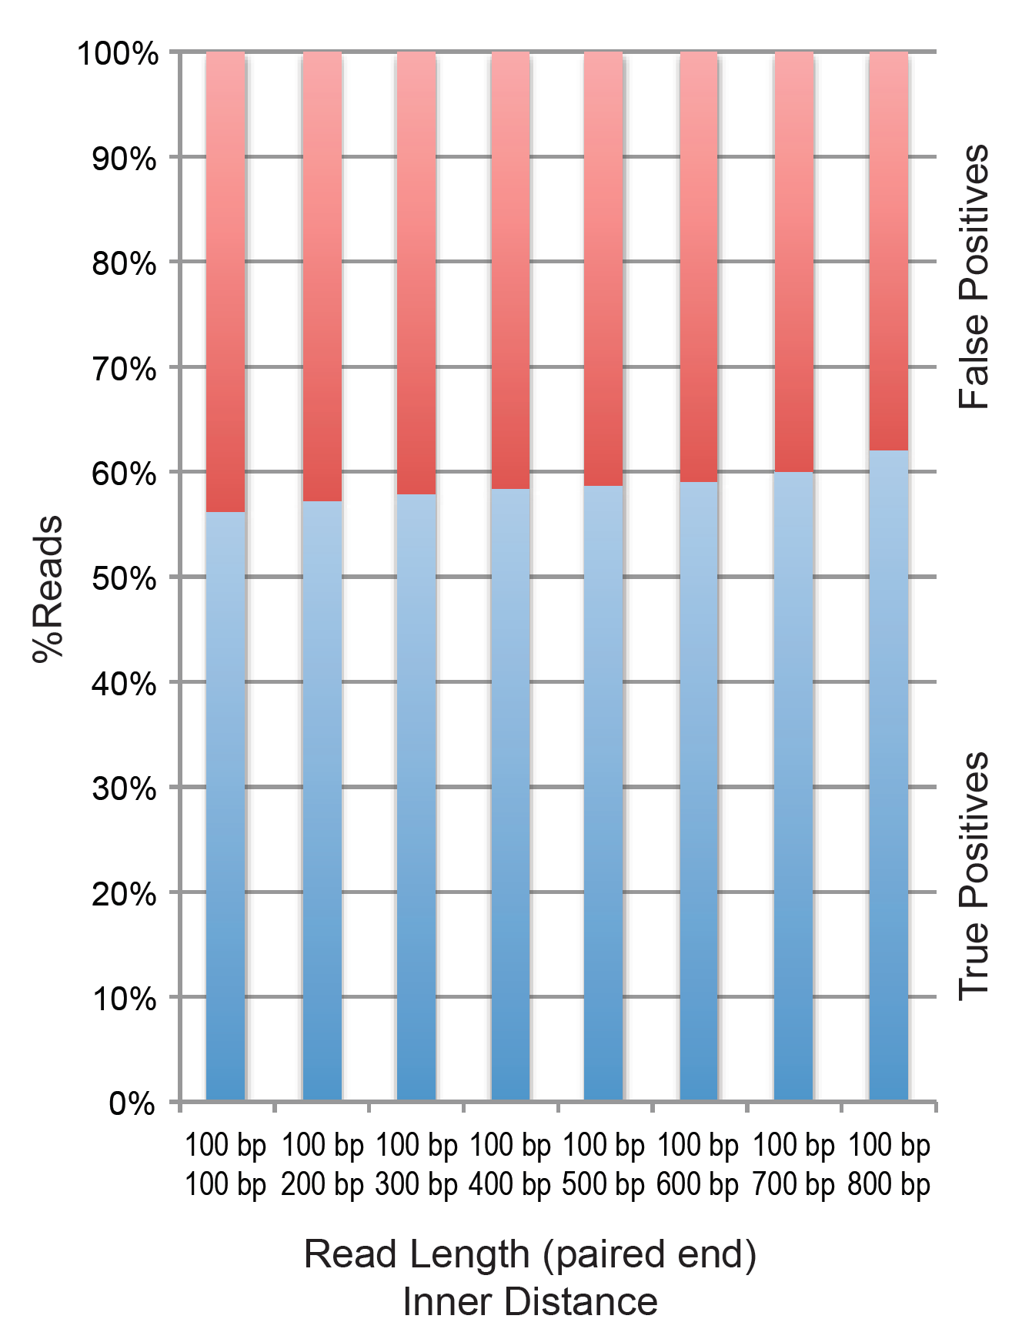
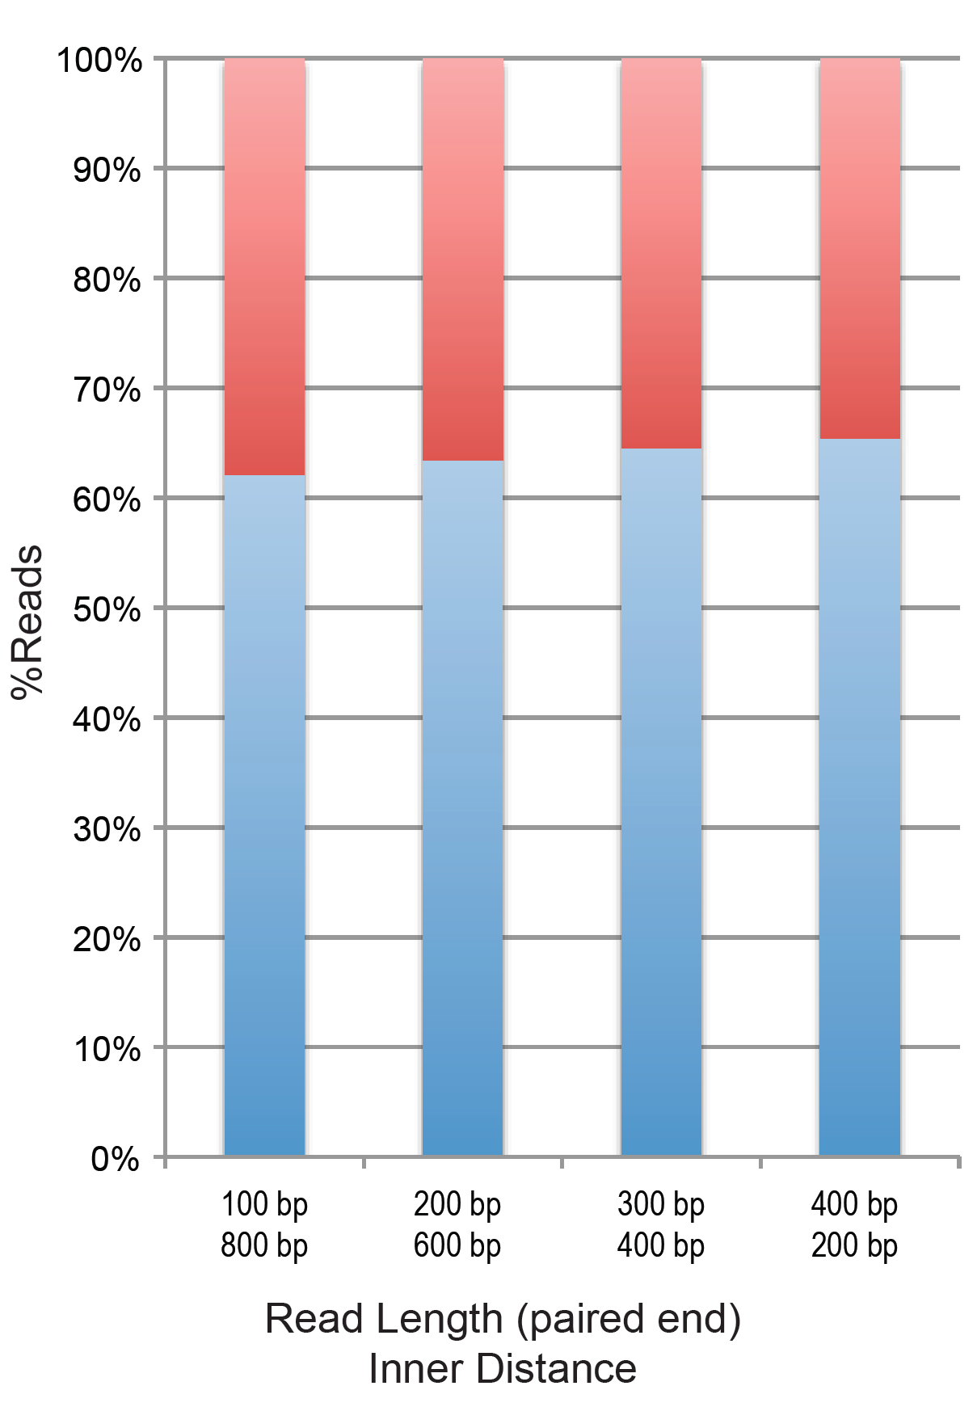
Paired-end data with longer fragment length improves accuracy, but not as significantly as expected
(single-end reads and 20x coverage)

Slide 24
Conclusions
Factors that impact accuracy of gene counts (and likely transcriptome assemblies) with RNA-Seq data -
Mapping “mode”
Composition of the genome/transcriptome, levels of alternatively spliced genes
Transcriptome “completeness”
Length of reads
Length of fragment paired reads
% of transcriptome expressed in the test tissue
Notes:
How you deal with reads that map to multiple locations/isoforms is important
More isoforms = More inaccurate mapping
Accurate isoform-specific transcription is very difficult to measure with the current generation of RNA-Seq data
A complete transcriptome is better than an incomplete one, but it has it’s own issues given the current methodologies
1000 nucleotide long reads may not be long enough for accuracy with isoform transcripts
Longer fragments for paired-end reads are only a little better than shorter fragments
Ditto for using long fragment lengths with current read lengths
Percentage of transcriptome expressed plays into accurate mapping of reads, especially when the transcriptome is incomplete

Slide 25
Thoughts and discussion points
Once you have differential expression information at the level of a gene, dig deep into the isoform level information for that gene using RNA-Seq and another method, and maybe do so for each exon independently (DEX-seq)
If there is no genome available, only a transcriptome, then it is even harder since you cannot easily identify the exon-exon junctions
If you are constructing a transcriptome, there are going to be a small number of spurious exon-exon boundaries, from splicing mistakes
Cufflinks makes an attempt to address some of these issues. E.g. assigning reads to isoforms unevenly based on read depth, making new isoforms if the reference transcriptome is missing an exon-exon junction, etc.

Slide 26
Thoughts and discussion points
Questions about methodology-
When random reads were generated, was the depth uneven across the genes, as it would be in real samples?
Were the simulated reads stranded?
Paper had a few mistakes (e.g. table 1) and some unexplained details
Should have mapped to the genome with a splice-aware mapper like Tophat or Star

